Slide 1
Voices of The Hill Website Process
David Harrison

Slide 2
Needs Assessment Report
Difficult to communicate with client about tangible aspects
Hard to tell what they like without examples
Learned: Understanding needs and getting a feel for what the client wants takes an iterative approach

Slide 3
Architecture Diagram
In my site this was relatively simple. Once the main pages were created, just needed a modular way to display content.
Can see how complex this can get with sites with a variety of content.

Slide 4
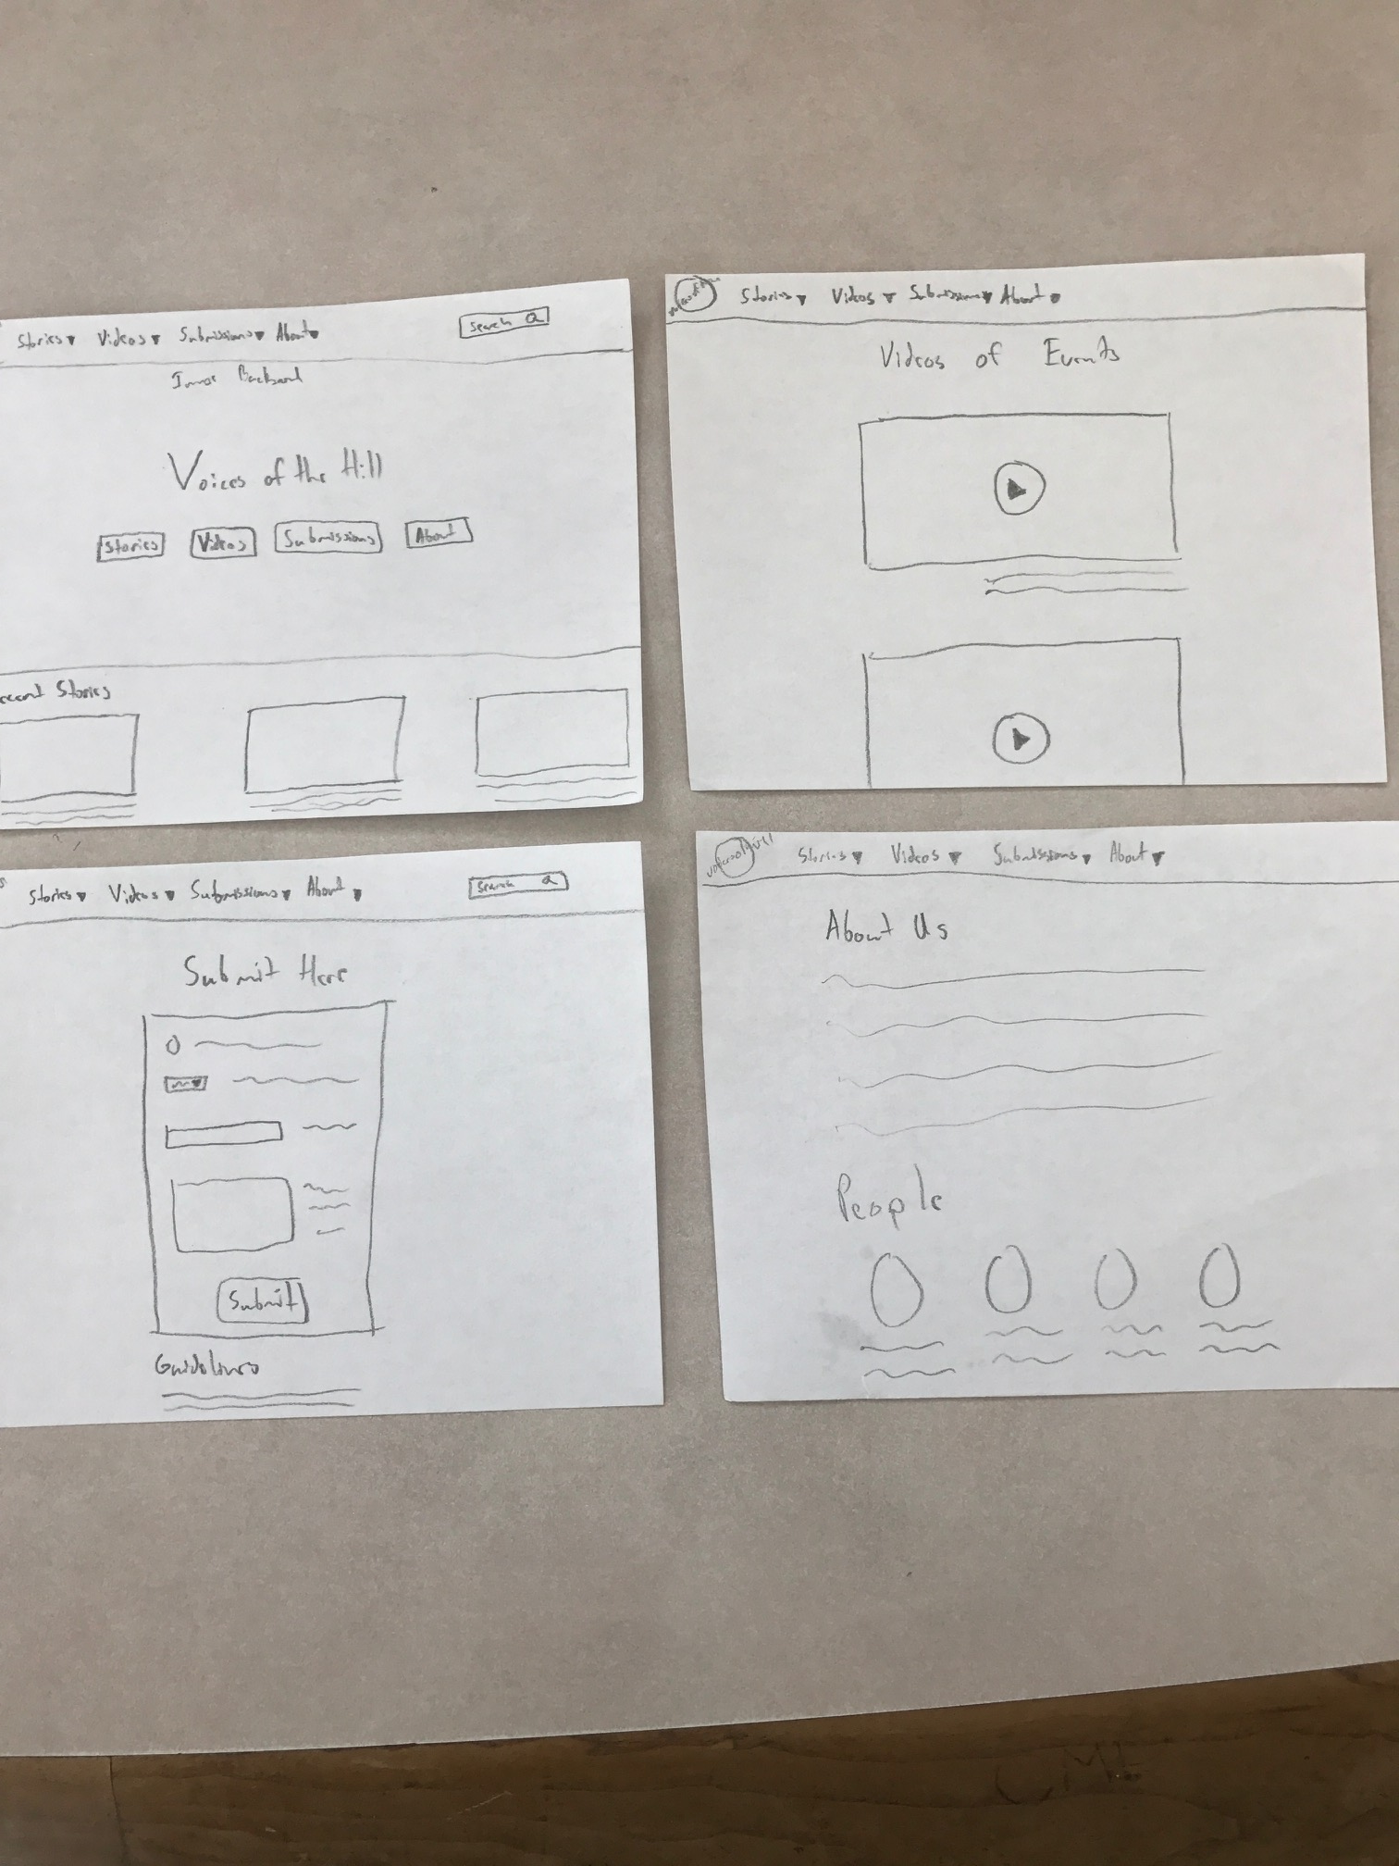
Sketches
Sketches were one of the harder tasks for me
Figuring out what visual space I wanted was difficult without knowing exactly what the content would look like

Slide 5
Wireframes
Wireframes were really useful for me to reference as I worked on the full site.
Figuring out the layout without basing it around the content itself was useful in how I pictured the full site
When I went back and redid many of the design choices on the site I used the wireframe over the mockup as I was trying to figure out a better use of whitespace

Slide 6
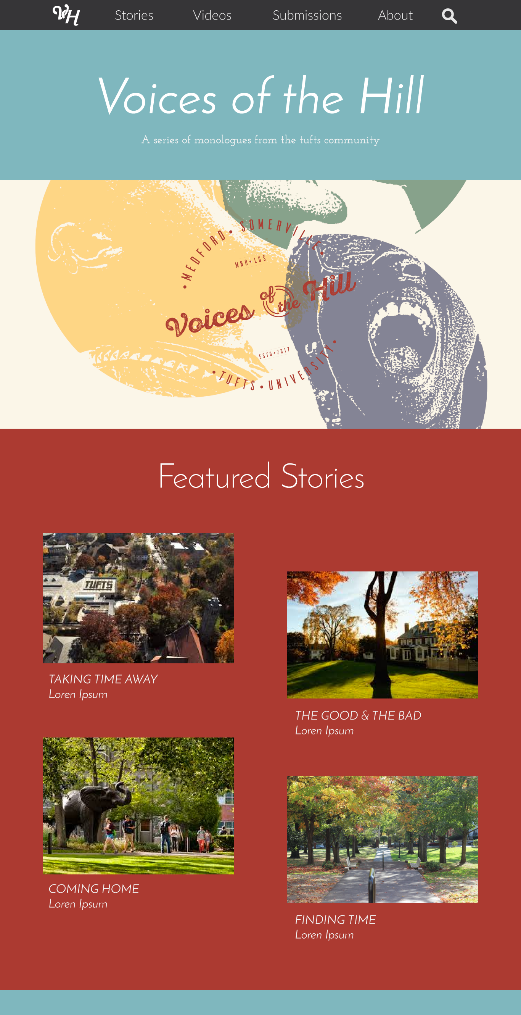
Mockup
Original mockup was a little too heavy on the background color and I wanted to make the content the most prominent aspect of each page
Iterating between mockup and the site as I was building it let me play around with some of the elements before I took the time to code them
Was fairly easy to build each element based on the hierarchy in the mockup

Slide 7
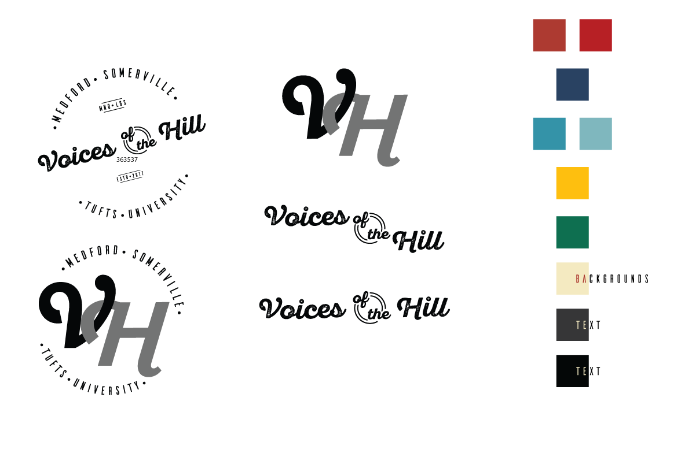

Slide 8
Website
Took an incredibly long time to get everything just the way I wanted it, but wasn’t too hard to get the elements on the page.
Making sure the CSS was a logical progression and could be used across elements helped
All the little details that go into a site were difficult to understand before doing the project
It was best to create a format for the elements that allowed the page to shift in size and dimension without changing the layout fully
Some basic javascript actions were easy to implement, but a few that I did took a while to figure out how to go about them

Slide 9
Website

